Slide 1
Tools of a Web Designer

Slide 2
Text Editor
Popular Free Tools
Notepad++, Sublime Text, Text Wrangler etc.
Integrated Development Environment
Adobe Dreamweaver, Eclipse, Microsoft Visual Studio, NetBeans etc.
Online Tools
Mozila Thimble, JS Fiddle and many more.

Slide 3
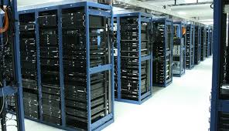
Web Hosting
Companies that have reliable servers with web server software installed.
Disk space, databases, software, bandwidth are all provided for a single monthly price.
Windows IIS and Linux Apache are the two main choices.

Slide 4
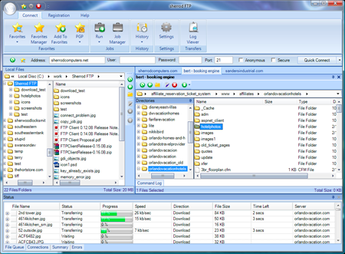
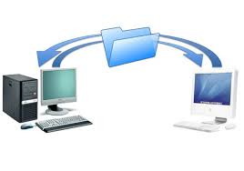
FTP (File Transfer Protocol)
An FTP client transfer files between your computer and a server.
Work on your HTML files on your computer. Upload them to the server when they are ready.

Slide 5
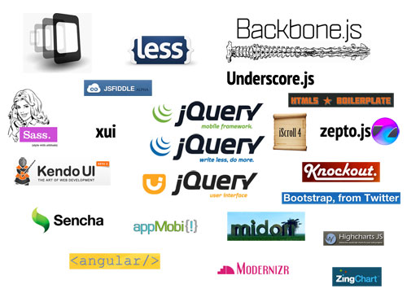
Frameworks and Libraries
Many programming and design problems have already been solved and tested by other people. Use the Internet to find these tools

